Slide 1
Design of Engineering Experiments
Chapter 2 – Some Basic Statistical Concepts
Describing sample data
  Random samples
  Sample mean, variance, standard deviation
  Populations versus samples
  Population mean, variance, standard deviation
  Estimating parameters
Simple comparative experiments
  The hypothesis testing framework
  The two-sample t-test
  Checking assumptions, validity

Slide 2
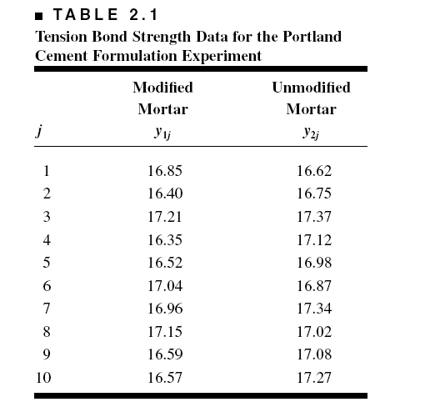
Portland Cement Formulation (page 24)

Slide 3
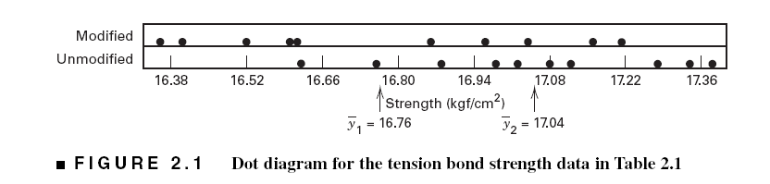
Graphical View of the Data
Dot Diagram, Fig. 2.1, pp. 24

Slide 4
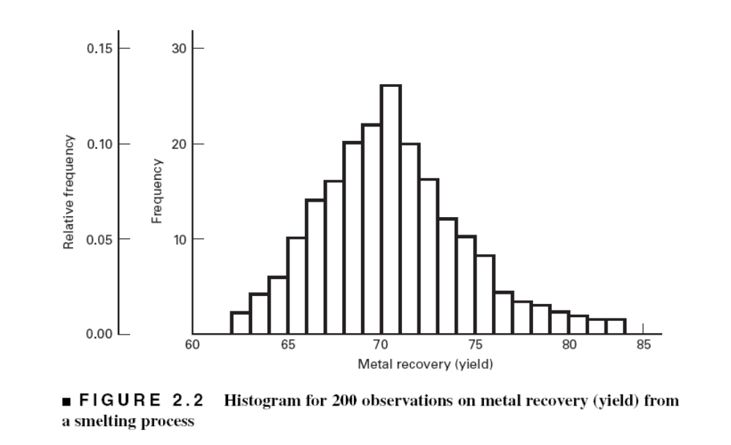
If you have a large sample, a histogram may be useful

Slide 5
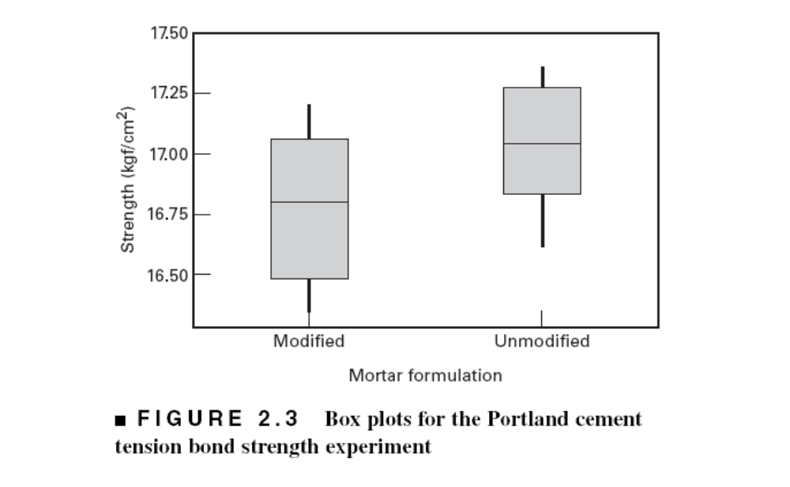
Box Plots, Fig. 2.3, pp. 26

Slide 6
The Hypothesis Testing Framework
Statistical hypothesis testing is a useful framework for many experimental situations
Origins of the methodology date from the early 1900s
We will use a procedure known as the two-sample t-test

Slide 7
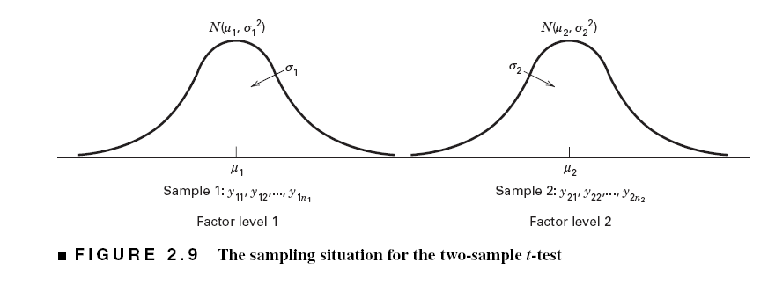
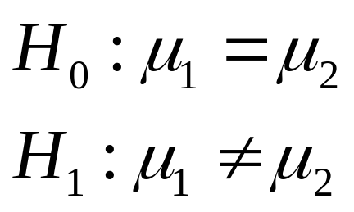
The Hypothesis Testing Framework
Sampling from a normal distribution
Statistical hypotheses:

Slide 8
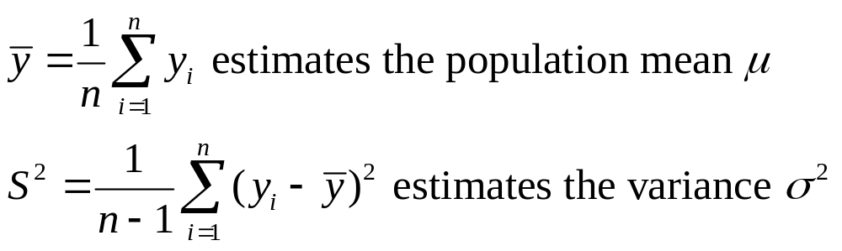
Estimation of Parameters

Slide 9
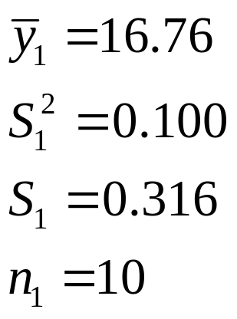
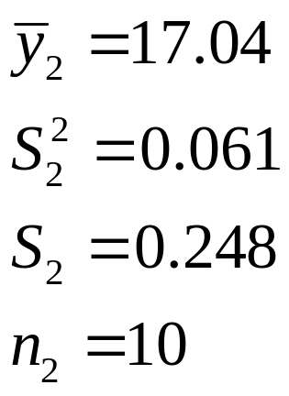
Summary Statistics (pg. 36)
Formulation 1
“New recipe”
Formulation 2
“Original recipe”

Slide 10
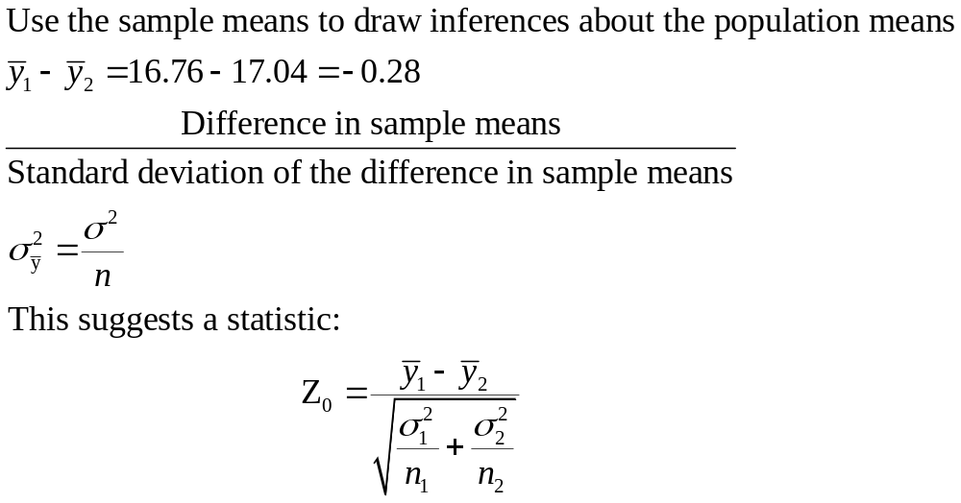
How the Two-Sample t-Test Works:

Slide 11
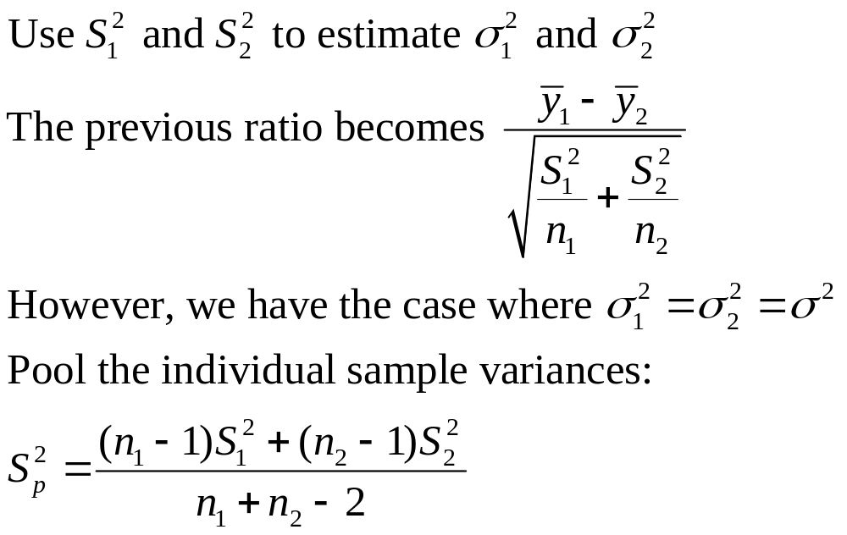
How the Two-Sample t-Test Works:

Slide 12
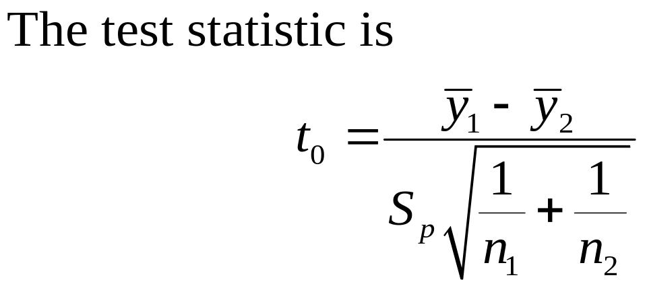
How the Two-Sample t-Test Works:
Values of t₀ that are near zero are consistent with the null hypothesis
Values of t₀ that are very different from zero are consistent with the alternative hypothesis
t₀ is a “distance” measure-how far apart the averages are expressed in standard deviation units
Notice the interpretation of t₀ as a signal-to-noise ratio

Slide 13
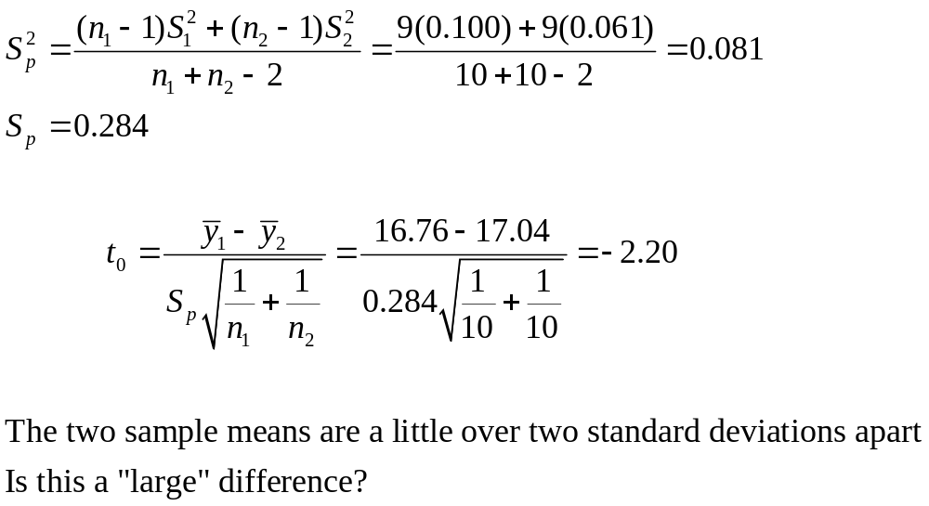
The Two-Sample (Pooled) t-Test

Slide 14
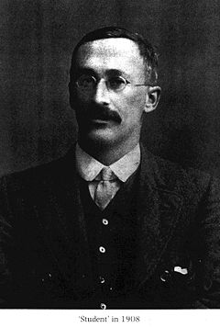
William Sealy Gosset (1876, 1937)
Gosset's interest in barley cultivation led him to speculate that design of experiments should aim, not only at improving the average yield, but also at breeding varieties whose yield was insensitive (robust) to variation in soil and climate.
Developed the t-test (1908)
Gosset was a friend of both Karl Pearson and R.A. Fisher, an achievement, for each had a monumental ego and a loathing for the other.
Gosset was a modest man who cut short an admirer with the comment that “Fisher would have discovered it all anyway.”

Slide 15
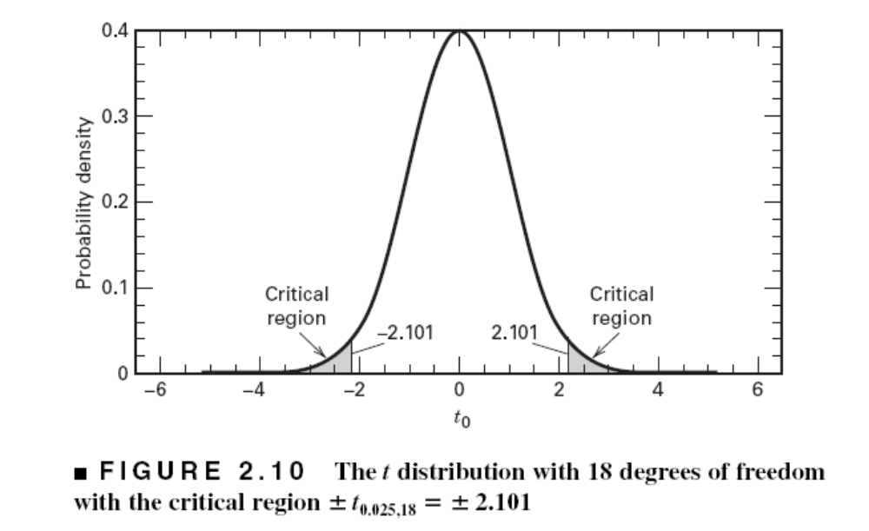
The Two-Sample (Pooled) t-Test
So far, we haven’t really done any “statistics”
We need an objective basis for deciding how large the test statistic t₀ really is
In 1908, W. S. Gosset derived the reference distribution for t₀ … called the t distribution
Tables of the t distribution – see textbook appendix
t₀ = -2.20

Slide 16
The Two-Sample (Pooled) t-Test
A value of t₀ between –2.101 and 2.101 is consistent with equality of means
It is possible for the means to be equal and t₀ to exceed either 2.101 or –2.101, but it would be a “rare event” … leads to the conclusion that the means are different
Could also use the P-value approach
t₀ = -2.20

Slide 17
The Two-Sample (Pooled) t-Test
t₀ = -2.20
The P-value is the area (probability) in the tails of the t-distribution beyond -2.20 + the probability beyond +2.20 (it’s a two-sided test)
The P-value is a measure of how unusual the value of the test statistic is given that the null hypothesis is true
The P-value the risk of wrongly rejecting the null hypothesis of equal means (it measures rareness of the event)
The P-value in our problem is P = 0.042

Slide 18
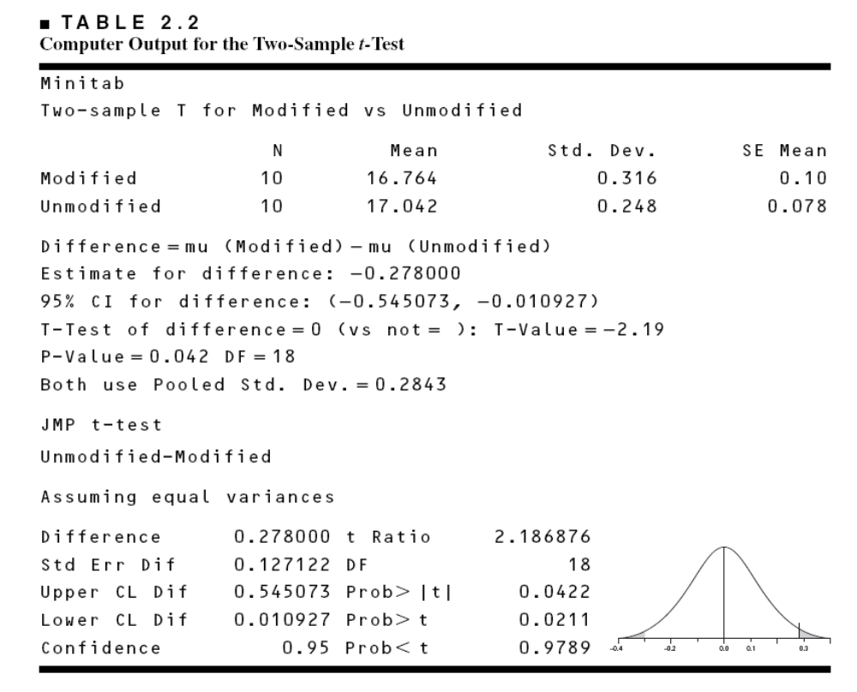
Computer Two-Sample t-Test Results

Slide 19
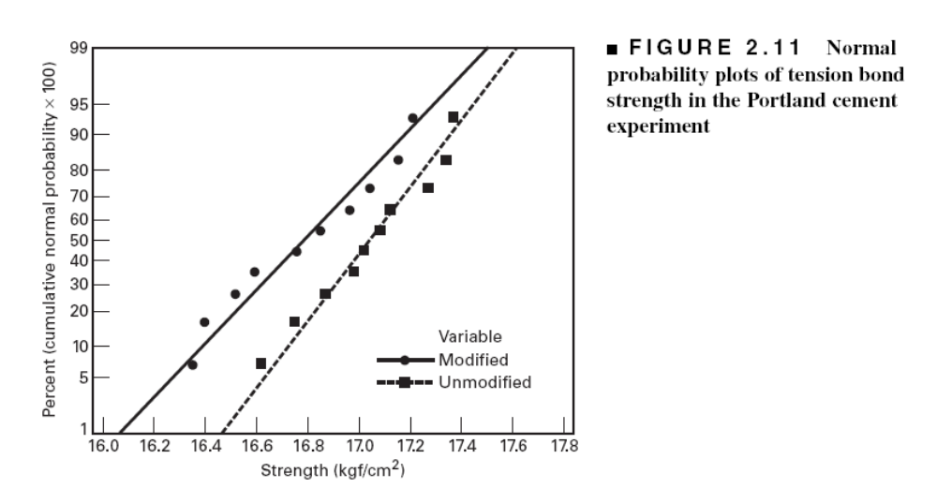
Checking Assumptions –
The Normal Probability Plot

Slide 20
Importance of the t-Test
Provides an objective framework for simple comparative experiments
Could be used to test all relevant hypotheses in a two-level factorial design, because all of these hypotheses involve the mean response at one “side” of the cube versus the mean response at the opposite “side” of the cube

Slide 21
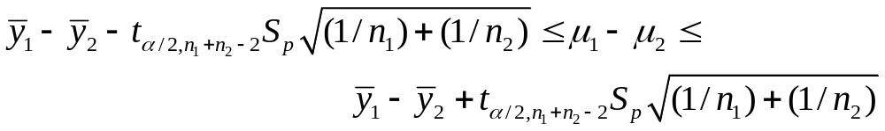
Confidence Intervals (See pg. 44)
Hypothesis testing gives an objective statement concerning the difference in means, but it doesn’t specify “how different” they are
General form of a confidence interval
The 100(1- α)% confidence interval on the difference in two means:

Slide 22
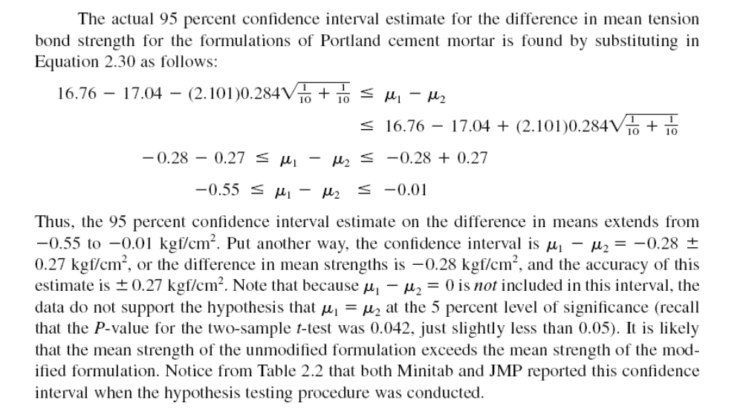

Slide 23
Other Chapter Topics
Hypothesis testing when the variances are known
One sample inference
Hypothesis tests on variances
Paired experiments

